Slide 1
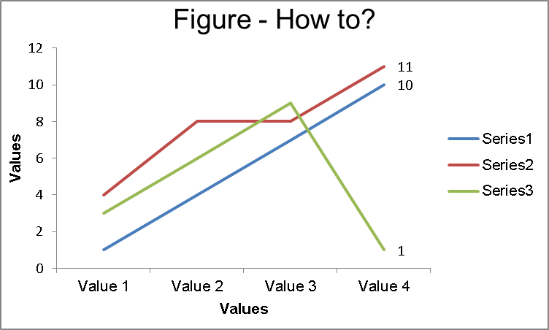
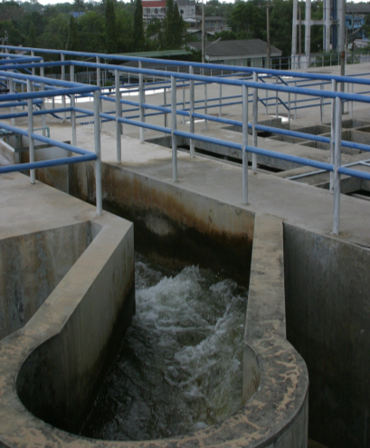
Title (style Title: Arial - 66pt - bold - centered) max. 20 words
Author name¹, Author name², Author name³
¹ Affiliation 1, contact details
² Affiliation 2, contact details
³ Affiliation 3, contact details
INTRODUCTION
Please insert the title as “Sample Layout for 90×120 cm poster: Keep it simple, no more than 300 words”.
This example demonstrates the layout of an example poster for presentation at IWARR2023. The purpose of a poster paper presentation is to promote informal discussion. It is a graphic display of a written manuscript. The poster presentation summarises the research and usually contains an overview of research objectives, experimental methods, materials, results, and a discussion. Often, a clear message in fewer words is more effective in poster presentations.
The colour palette should be as presented (IWARR2023 dark blue – RGB:24/46/61, IWARR2023 blue – RGB: 0/165/165), font should all be ARIAL (Title = 66 points – white, Author names = 40 points – dark blue, Affiliation = 36 points – dark blue, Chapter title = 48 points – white, Text = 24 points – dark blue aligned to the left, Captions and text remarks about figures = 20 points – dark blue aligned to the left).
Use graphs whenever possible but do not overkill information per graph. Avoid very large tables, present them only with horizontal lines.
METHOD
DISCUSSION
The key message is that an interested individual not necessarily familiar with your field of expertise should be able to follow your poster. The purpose of poster paper presentations is to promote informal discussion. To achieve your goal, you’ll need to do two things:
A clear message (imagine a poster as an illustrated abstract);
An attractive and clear layout.
You should use this template to make the best out of your poster. We provide an attractive layout and guidance, you provide the content and the best of your work.
Each paragraph should have more than two sentences and less than five sentences. Each sentence shouldn’t have more than 30 words. Use bullet points whenever it is possible, your audience will read them and discuss them with you. Use figures to structure your message and to show your key findings.
Focus on the key questions you want to answer. Begin by answering the “Why?” are you working on this followed by, “What am I adding?”, “How? Methods”, “What did I find?” and “What do I recommend?”
The clear areas between paragraphs and chapters are valuable. A direct message presented using a clear structure is easier to read and will attract your audience [1].
Table 1 How to build a table for a poster
Title
Value 1 | 1 | 2 | 3
Value 2 | 4 | 5 | 6
Value 3 | 7 | 8 | 9
Value 4 | 10 | 11 | 12
This table only shows key figures. It is light and easily understandable, and self-explanatory. The side box only gives some hints about what is in the table
Fill with text. Fill with text. Fill with text. Fill with text. Fill with text. Fill with text. Fill with text. Fill with text. Fill with text. Fill with text. Fill with text. Fill with text. Fill with text. Fill with text. Fill with text. Fill with text. Fill with text. Fill with text. Fill with text. Fill with text. Fill with text. Fill with text. Fill with text.
Fill with text. Fill with text. Fill with text. Fill with text. Fill with text. Fill with text. Fill with text. Fill with text. Fill with text. Fill with text. Fill with text. Fill with text. Fill with text. Fill with text. Fill with text. Fill with text. Fill with text. Fill with text. Fill with text. Fill with text. Fill with text. Fill with text.
RESULTS
This figure shows trends, it is light and easily understandable and self-explanatory. The side box only gives some hints about what is in the figure.
Use figures to support your text. The average visitor will pay more attention to figures than text, keeping it short and simple.
Fill with text. Fill with text. Fill with text. Fill with text. Fill with text. Fill with text. Fill with text. Fill with text. Fill with text. Fill with text. Fill with text. Fill with text. Fill with text. Fill with text. Fill with text. Fill with text. Fill with text. Fill with text. Fill with text. Fill with text. Fill with text. Fill with text. Fill with text.
Fill with text. Fill with text. Fill with text. Fill with text. Fill with text. Fill with text. Fill with text. Fill with text. Fill with text. Fill with text. Fill with text. Fill with text. Fill with text. Fill with text. Fill with text. Fill with text. Fill with text. Fill with text. Fill with text. Fill with text. Fill with text. Fill with text.
Fill with text. Fill with text. Fill with text. Fill with text. Fill with text. Fill with text. Fill with text. Fill with text. Fill with text. Fill with text. Fill with text. Fill with text. Fill with text. Fill with text. Fill with text.
Figure 1 How to build a graph for a poster
CONCLUSION
Finish with a brief conclusion. Summarise your findings and list the key points of your research.
Be brief and direct
This shows the outcome of all of your efforts
The pictures are used to show key points of the research. You should use them but avoid resolution overkill, more than 150 dpi but less than 300 dpi.
Save photos as .jpg or .png (graphs as png) and consider that web images are usually poor resolution.
If the picture is not yours, acknowledge the intellectual property of it.
Figure 1 How to insert a figure (source: IWA)
References: List your references here. [1] Doe, J; Doe, J; Poster Template for Authors, IWARR2023 Committee.
Acknowledgement: Use this box to acknowledge your partners and sponsors. The conference secretariat would like to thank you for your submissions and willingness to apply our template and follow our advice.

