Slide 1



Title
Subtitle
Name, Organization, Country
Date

Slide 2
BEFORE YOU GET STARTED - KEY OVERALL TIPS
Start with the structure of your presentation
  What is the key message you wish to convey (e.g., one key conclusion) you want to present?
  Then draw out what are the key findings that help you deliver your key message (e.g., your analysis/ data that supports / the key lessons in your project that support the key message)
Rule of thumb: 1 slide per minute (8 minutes is 8 slides)
Assume you need to present your work to a family member or friend not working in the water sector. Two mandatory slides:
  One introductory slide (see slide 3)
  One ‘how your work makes an impact’ slide (see slide 8)
Feel free to adjust the titles of this template to suit your needs.

Slide 3
YOUR WORK IN RESOURCE RECOVERY
This slide presents where your work or research sits in resource recovery or relates to resource recovery. This is to ensure:
  Inform all participants (even those outside of your expertise) know what you are talking about
  Ensure thoughtful consideration of your strategic positioning within the sector.
You may use a picture or find another way to introduce your work in the broader water cycle.
Adding the rationale for your work, research, or project may fit nicely into this section.

Slide 4
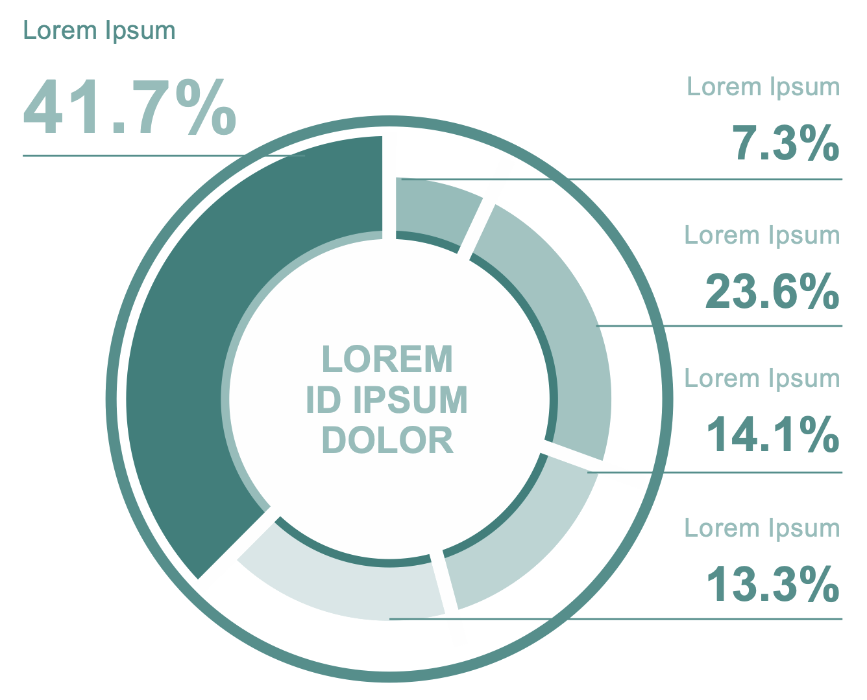
YOUR METHODOLOGY/APPROACH TO WORK

Slide 5
YOUR FINDINGS
Choose your figures, photos, or illustrations well
  Do not show all your results. Only those that support the key conclusions you wish to present

Slide 6
YOUR FINDINGS CONTINUED

Slide 7
YOUR CONCLUSION

Slide 8
HOW IS YOUR WORK MAKING AN IMPACT
What next: now that your research or work has been finished, this section allows you present:
  What will be done with your work/results/findings?
  How will it influence resource recovery?
  What should happen next? (recommendations)
‘Contact me’ section:
  Highlight your name again (you don't have to mention this), as people can search for you.
  Include a website address if relevant.

